Slide 1
Decisions Multiple Outcomes
ICS 3U0

Slide 2
Today’s Agenda
Decisions with multiple outcomes using IF ELIF statements

Slide 3
Recall: Conditions
Remember that all conditions must resolve to either TRUE or FALSE values. For example:
if age < 16:
if sum >= 12:
if ratio > 4/3:
if street == "Main":
if city != "Ottawa":

Slide 4
Recall: IF ELSE Statement
In general, in a program conditions are tested, and depending on the result, further statements are executed: if condition:
statements for condition TRUE
else:
statements for condition FALSE
We use this setup when there are two outcomes.
What if we have a problem with more than two outcomes?

Slide 5
Example: Provincial Capitals
# Input a province from the user
province = input("Enter a province: ")
# If the province is Ontario then output the capital to be Toronto
if province == "Ontario":
print("Capital is Toronto")
# If the province is Nova Scotia then output the capital to be Halifax
elif province == "Nova Scotia":
print("Capital is Halifax")
# If the province is none of the three then output that you don’t know ☺
else:
print("I don't know the capital.")

Slide 6
Build on this Example
As you can see, the elif statement allows us to test several “true” conditions (check each of the provinces), and then have a single response to a “false” condition (all the checks failed, we don’t know what province the user entered).
Using this statement, we can now easily add two more provinces to the program (e.g., British Columbia and Quebec)

Slide 7
IF ELIF - Provincial Capitals
# Get a province from the user
province = input("Enter a province: ")
# if the province is Ontario then output the capital to be Toronto
if province == "Ontario":
print("Capital is Toronto")
# if the province is Nova Scotia then output the capital to be Halifax
elif province == "Nova Scotia":
print("Capital is Halifax")
# if the province is British Columbia then output the capital to be Victoria
elif province == "British Columbia":
print("Capital is Victoria")
# if the province is Quebec then output the capital to be Quebec City
elif province == "Quebec":
print("Capital is Quebec City")
# if the province is none of the three then output that you don’t know ☺
else:
print("I don't know the capital. ")

Slide 8
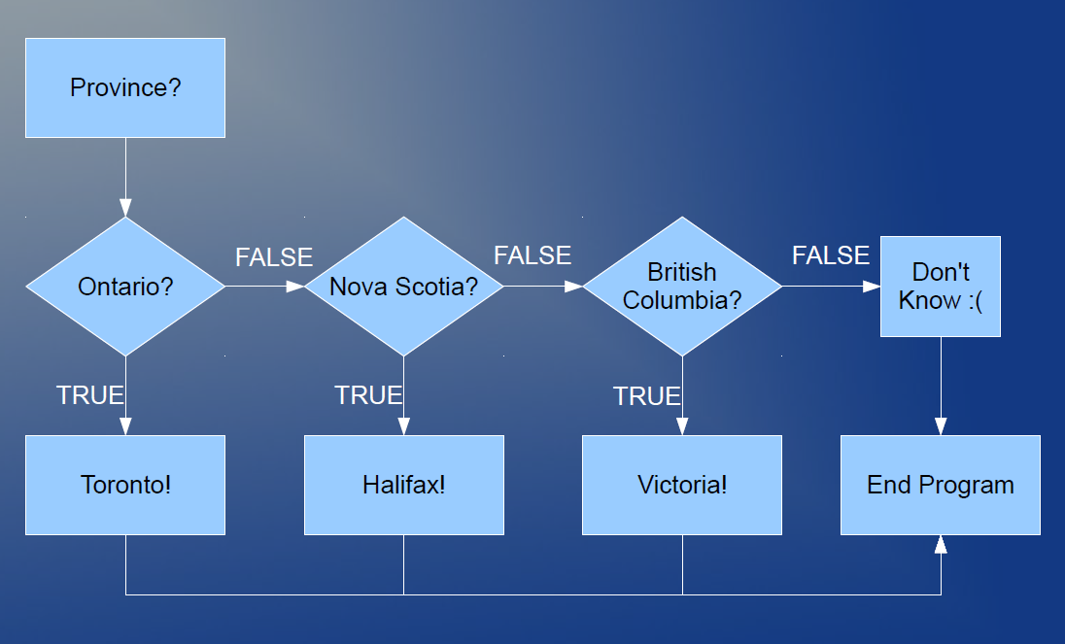
IF ELIF - Provincial Capitals

Slide 9
Example – Look at this code
A student wrote a program that tells the user it is “Chilly” outside if the temperature is less than 10 degrees Celsius, and that it is “Brrrrr” if it is less than 0 degrees Celsius. Is the code correct? If not, how can we change it?
temperature = int(input("Enter the temperature: "))
if temperature < 10:
print("Chilly!")
if temperature < 0:
print("Brrrr!")

Slide 10
Example – Order Matters
A student wrote a program that outputs different comments depending on the user’s age. Can you see how the output would be different if the conditions were in a different order?
age = int(input("How old are you? "))
if age < 3:
print("You're a baby!")
elif age < 13:
print("You're a kid!")
elif age < 18:
print("You're a teen!")
else:
print("You're an adult!")

Slide 11
Exercises – Decisions Multiple Outcomes
Open Exercise 2.2 –
Day 1 Decisions -Multiple Outcomes
Day 2 Decisions -Multiple Outcomes

